Slide 1
Neural Activity Translatorlol
Group 5:
Isaac Lickona, Robert Schaefer,
Daniel Riehm, Joseph Delle Donne
Notes:
Robbie Will introduce

Slide 2
Needs Assessment
Group 5 plans to create a MATLAB program that can interpret data collected from an electrode sensor that is monitoring a user’s brain functions. Utilizing OpenViBe, an application capable of processing and classifying real-time brain functions, sets of brainwave data will be translated into comprehensible data.

Slide 3
Problem Formulation / Abstraction & Synthesis
Provide an accurate interface between the human brain and a MATLAB script
Design a model that can interpret data meaningfully and accurately
Display data in intelligible and useful form
Determine the validity and consistency of data among various users
Write code efficient enough to perform real-time

Slide 4
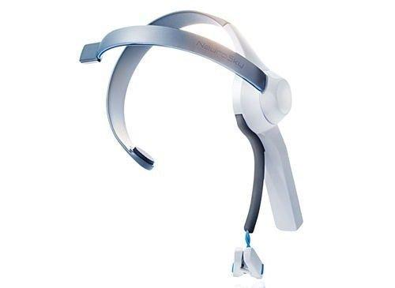
The NeuroSky Mindwave
$70

Slide 5
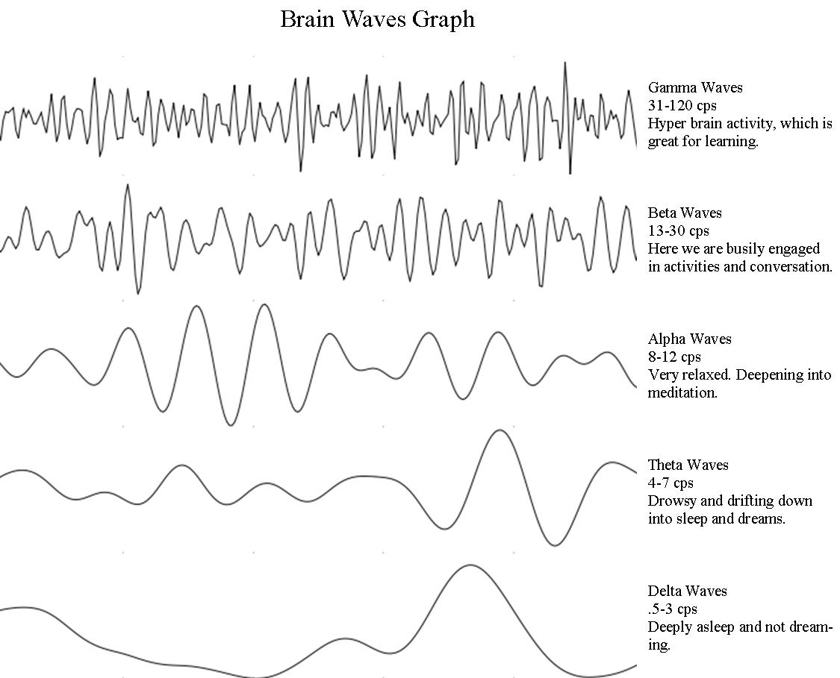
Problem Formulation / Abstraction and Synthesis (cont)
Parameters:
Measuring from approximately 2-50 Hz
Expect mostly alpha and beta waves
Frequency bounds for brainwaves
(may change with different people)
Alpha: 8-12 Hz
Beta: 13-30 Hz

Slide 6
Problem Formulation / Abstraction and Synthesis
Assumptions:
Differences in frequency will be clear enough to distinguish between waves
User will be able to adequately control brainwave activity
Type of wave determines “answer”
Alpha vs Beta

Slide 7
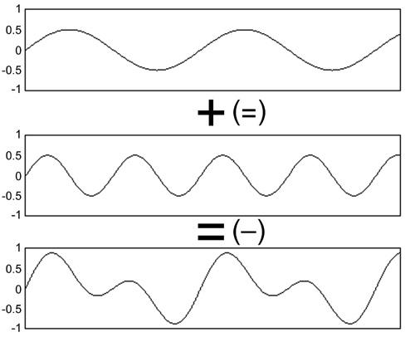
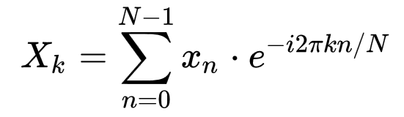
Analysis
Brain data is brought into OpenVibe software as waves. OpenVibe exports directly to MATLAB.
The frequency of these waves can be analyzed using a Discrete Fourier Transform:
Notes:
--Daniel will explain the Fourier Transform (calculating frequency)--

Slide 8
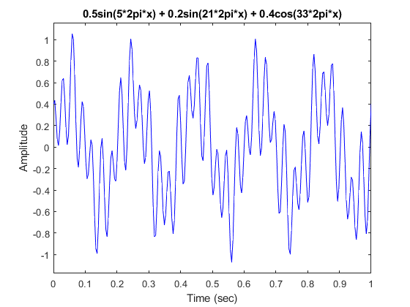
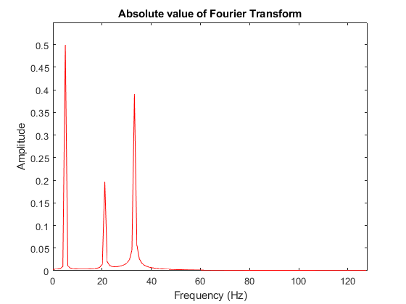
MATLAB fft(x)

Slide 9
Implementation
Measuring relative prevalence of different frequency waves allows for a binary interpretation
Brainwave Activity Graph → GUI compatible
Live stream? Refresh?
Controlling the prevalence of different waves is up to the user wearing the data collection apparatus
Comparing results to easy true / false quiz
YES or NO answers must pass time, intensity thresholds

Slide 10
Looking Forward
Acquire Mindwave apparatus and examine the efficiency of the wave outputs
Identify bounds for wave frequencies
Evaluate legitimacy of our assumptions
Distinction of waves
User control of brain activity
Apply to other methods of translation
Morse Code

Slide 11
References
“What is the Function of the Various Brainwaves?” Scientific American, 22 Dec. 1997. Web. 7 Mar 2018. <www.scientificamerican.com/article/what-is-the-function-of-t-1997-12-22>.
Wikipedia contributors. "Discrete Fourier transform." Wikipedia, The Free Encyclopedia. Wikipedia, The Free Encyclopedia, 3 Mar. 2018. Web. 7 Mar. 2018. <https://en.wikipedia.org/wiki/Discrete_Fourier_transform>
Images
(Mindwave) <https://store.neurosky.com/pages/mindwave>
(Brain Waves) <https://learn.sparkfun.com/tutorials/hackers-in-residence---hacking-mindwave-mobile>
(DFT Equation) <https://en.wikipedia.org/wiki/Discrete_Fourier_transform>
(Wave Addition) <http://sites.music.columbia.edu/cmc/MusicAndComputers/chapter3/03_03.php>

